Slide 1
AES Encryption Implementation
Liam Kelly
Assignment 1
ITIS 6240

Slide 2
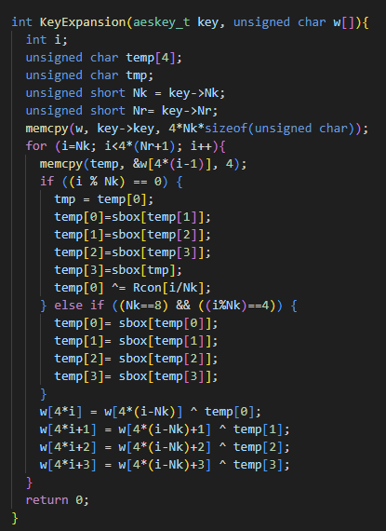
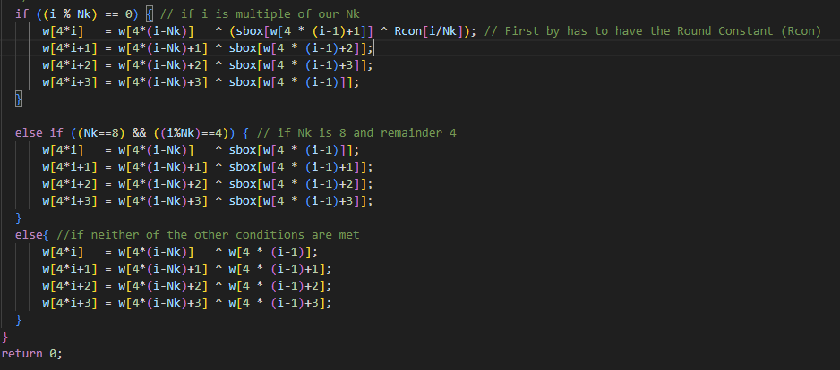
Code Segments Changed – KeyExpansion()
Original
This segment of code had many temporary variables being instantiated unnecessarily. To help with efficiency I removed the temp array and used manual calls instead when XORing during key expansion
My code

Slide 3
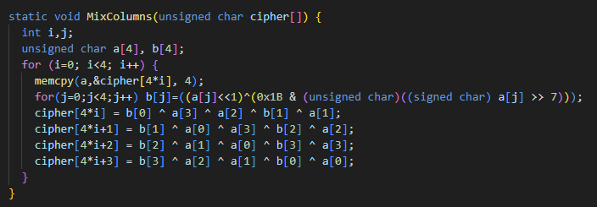
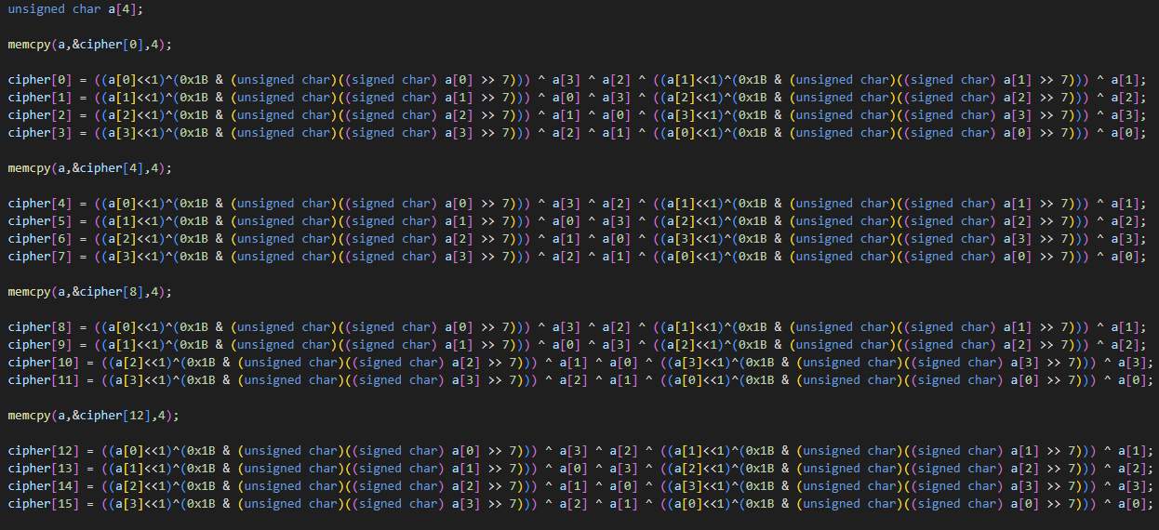
Code Segments Changed – MixColumns()
Original
The changes made to this section of code achieved two things. First, the for-loop was a set length (16) so I was able to remove that by hardcoding every line of the loop. Second, the array b[] was taking up memory that we did not need to use. Instead of a b[] array, the calls were done manually. This also removed the second for-loop. One other change I made was instead of multiplying i against 4 ([4*i]) in the index I simply incremented it manually – slightly reducing overhead.
My Code

Slide 4

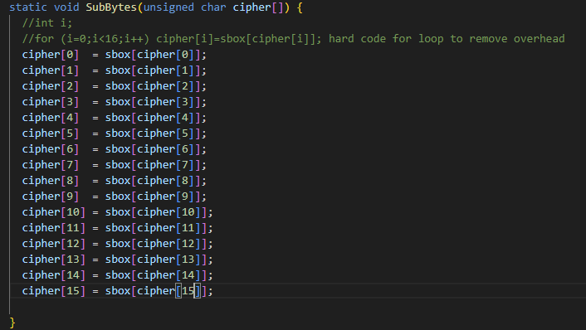
Code Segments Changed – SubBytes()
Original
My Code
This code change is simple. The set length for-loop is hard coded to avoid the overhead cost of a for loop.

Slide 5
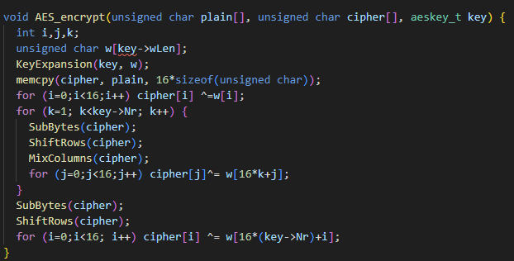
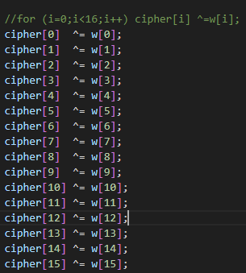
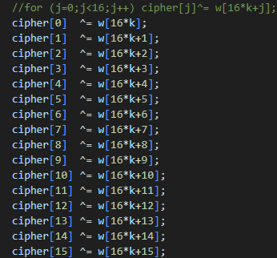
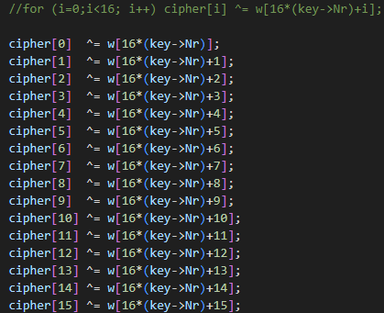
Code Segments Changed – AES_encrypt()
Original
My Code
Similar to the last slide, some of the for loops in this function could be hard coded to avoid looping. These were the final changes I made to my code.

Slide 6
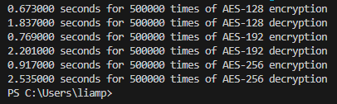
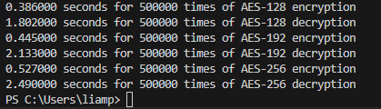
Original Encryption Time for aes0.c
Edited Encryption Time for aes0.c – Liam Kelly

